Slide 1
The transformations
Basics
Part II
The transformations
Basics
Part II

Slide 2
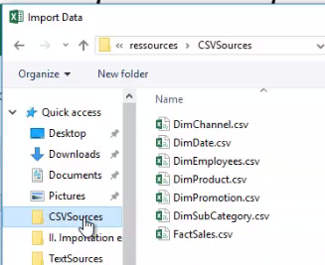
Basic transformations Part II
Note: This Lab uses the DimEmployees.csv file located in the resources/ CSVSources folder
DimEmployees .csv file location page
Navigate to the location of the DimEmployees.csv file .

Slide 3
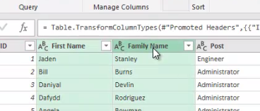
Basic transformations Part II
Load the file into the editor and notice that the table is made up of four columns:
ID , First Name , Family Name , and Post .
Select the "First Name" and " Family Name" columns .

Slide 4
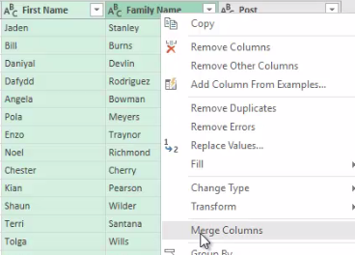
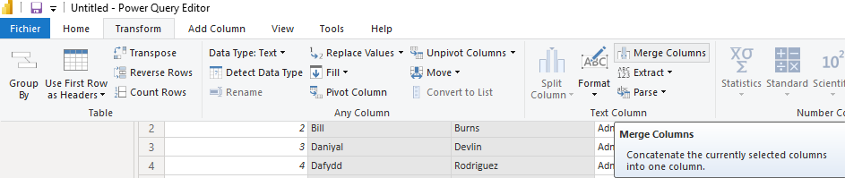
Basic transformations Part II
Right-click and observe the presence of the Merge Columns feature ( Merge Columns ).
same functionality in the Transform tab .

Slide 5
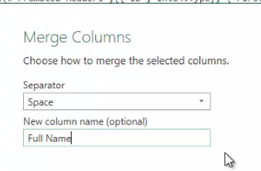
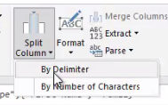
Basic transformations Part II
Change the separator setting to "Space" , rename the column to "Full Name" , and then click OK .
Try going back using the Split Column feature ( Split Column ) still in the Transform tab .

Slide 6
THANKS
THANKS

